Slide 1
Week4_Lecture3
Pointers to Objects
this Pointer
Pointers to class members

Slide 2
Pointers to Objects
When accessing members of a class given a pointer to an object, use the arrow (–>) operator instead of the dot operator.
#include <iostream> using namespace std; class cl { int i; public: cl(int j) { i=j; } int get_i() { return i; } };
int main() { cl ob(88), *p; p = &ob; // get address of ob cout << p->get_i(); // use -> to call get_i() return 0; }
Output
88

Slide 3
Example
int main()
{ cl ob[3] = {1, 2, 3}; cl *p; int i;
p = ob; // get start of array for(i=0; i<3; i++)
{ cout << p->get_i() << "\n"; p++; // point to next object } return 0;
}
#include <iostream> using namespace std; class cl
{ int i; public: cl()
{
i=0;
} cl(int j)
{ i=j; }
int get_i() { return i; }
};
Output
1
2
3

Slide 4
this pointer
Member functions of every object have access to a special constant pointer named this.
It points to the object itself.
It is passed automatically as an implicit argument to the invoking member function.
class ABC
{ int a;
public:
void set()
{ a = 10; }
};
class ABC
{ int a;
public:
void set()
{ this->a = 10; }
};

Slide 5
Contd…
Static member functions do not have 'this' pointer as they can be called without any object using the class name.
Not passed to friend functions as they are not member functions of a class.
Used when a binary operator is overloaded using a member function.
Used to return the object it points to.

Slide 6
Example 1
#include <iostream>
using namespace std;
class ABC
{ private:
char charray[10];
public:
void reveal()
{
cout << "\nMy object's address is " << this;
}
};
int main()
{ ABC w1, w2;
w1.reveal();
w2.reveal();
cout << endl;
return 0;
}
Output
My object's address is 0x6ffe40
My object's address is 0x6ffe30

Slide 7
Example 2
#include<iostream>
#include<cstring>
using namespace std;
class person
{ char name[20];
int age;
public:
void setData(const char *s, int a)
{ strcpy(name, s);
age = a; }
person& greater(person &x)
{ if(x.age >= age) return x;
else return *this; }
void display()
{ cout << name << " with age " << age; }
};

Slide 8
Contd…
int main()
{ person p1,p2,p3;
p1.setData("Abha", 21);
p2.setData("Akhil", 29);
p3.setData("Mitali", 31);
person p = p1.greater(p2);
cout << "Elder person is: ";
p.display();
p = p2.greater(p3);
cout << endl << "Elder person is: ";
p.display();
return 0;
}
Output
Elder person is: Akhil with age 29
Elder person is: Mitali with age 31

Slide 9
Pointers to Class Members
A special type of pointer that "points" generically to a member of a class, not to a specific instance of that member in an object.
This sort of pointer is called a pointer to a class member or a pointer-to-member.
A pointer to a member is not the same as a normal C++ pointer. Instead, a pointer to a member provides only an offset into an object of the member's class at which that member can be found.

Slide 10
Contd…..
Since member pointers are not true pointers, the . and -> cannot be applied to them.
To access a member of a class given a pointer to it, use the special pointer-to-member operators .* and –>*.
Their job is to allow you to access a member of a class given a pointer to that member.

Slide 11
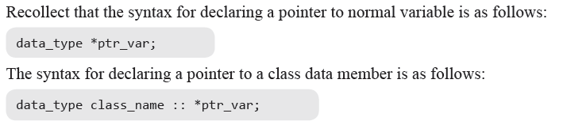
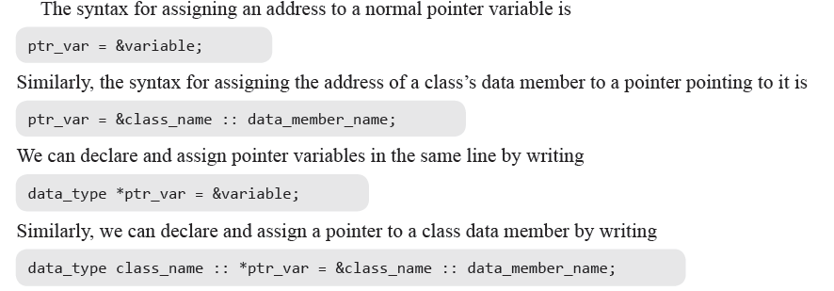
Declaring and Assigning Pointer to Data Members of a Class

Slide 12
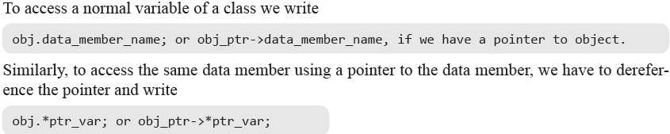
Accessing Data Members Using Pointers

Slide 13
Example
#include<iostream>
using namespace std;
class Test
{
public :
int x;
void show_data();
};
void Test :: show_data()
{
cout<<“\n x=“<<x;
}
int main()
{
Test t;
int Test :: *ptr=&Test::x;
t.*ptr=20;
t.show_data();
Test *tp= new Test;
tp->*ptr=80;
tp->show_data();
return 0;
}
Output
X=20
X=80

Slide 14
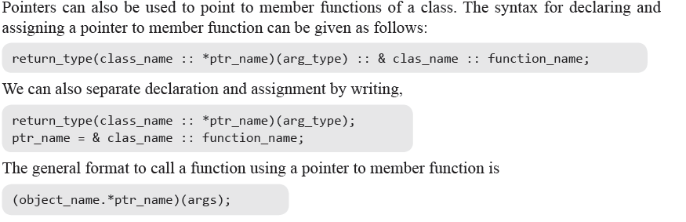
Pointer to member function

Slide 15
Example 1
int main()
{
// declare pointer to data member
int X::*ptiptr = &X::a;
// declare a pointer to member function
void (X::* ptfptr) (int) = &X::f;
// create an object of class type X
X xobject;
// initialize data member
xobject.*ptiptr = 10;
cout << "The value of a is " << xobject.*ptiptr << endl;
// call member function
(xobject.*ptfptr) (20);
}
#include <iostream>
using namespace std;
class X
{
public:
int a;
void f(int b)
{
cout << "The value of b is "<< b << endl;
}
};
Output
The value of a is 10
The value of b is 20

Slide 16
Example 2
#include <iostream> using namespace std; class cl
{ public: cl(int i) { val=i; } int val; int double_val()
{ return val+val; }
}; int main() { int cl::*data; // data member pointer int (cl::*func)(); // function member pointer cl ob1(1), ob2(2); // create objects
data = &cl::val; // get offset of val func = &cl::double_val; // get offset of double_val() cout << "Here are values: "; cout << ob1.*data << " " << ob2.*data << "\n"; cout << "Here they are doubled: "; cout << (ob1.*func)() << " "; cout << (ob2.*func)() << "\n"; return 0; }
Output
Here are values: 1 2
Here they are doubled: 2 4

Slide 17
Thank You

